Slide 1
MECHANICAL COMPARATORS
The Dial Gauge
The Level Comparator
Reed Type Mechanical Comparator
Passameter External Indicating Gauge
5. Sigma Comparator
6. Johnson Mikrokrator

Slide 2
MECHANICAL COMPARATORS
2. The Level Comparator:
This comparator works on the principle of sensitive level
It was designed by A.J.C.Brookes of the N.P.L, in the end of 1st world war
It was used for measurement concerned with subdivision of standard length gauges
Principle of instrument is shown in figure
A sensitive level tube is used for the measuring unit, this is attached to a mounting fitted with two ball feet about 3/4 inch apart

Slide 3
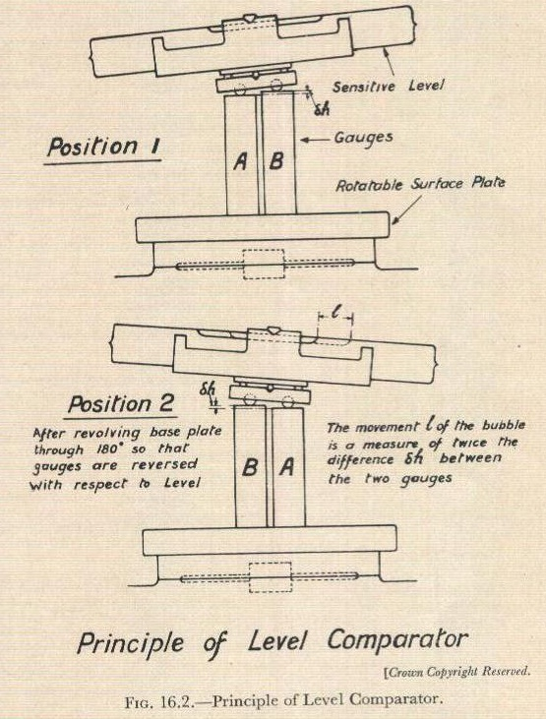

Slide 4
MECHANICAL COMPARATORS
2. The Level Comparator:
The base of comparator is of rotatable surface plate with a lapped upper surface, which remains in a true plane when the plate is rotated about a central axis
The comparator is used for comparing the sizes of two length gauges denoted by A & B respectively in figure
These gauges are wrung on to platen, & at the same time, one ball foot rests on each of the opposite ends of the two gauges
A reading is taken first when the gauges are shown in position A-B, The level is then raised & platen turn through 180 degree
After lowering the level on to the gauges a second reading is taken with the gauges in B-A Position

Slide 5
MECHANICAL COMPARATORS
2. The Level Comparator:
Assuming that a difference in length exists b/w the two gauges being checked, then the difference b/w the two readings obtained is distance equivalent to twice the difference in the length of the two gauges
This instrument, which can be used for checking length gauges up to about 40 inch ling is capable of establishing dimensional differences of the order of one-millionth of an inch

Slide 6
MECHANICAL COMPARATORS
3. Reed Type Mechanical Comparator:
The reed mechanism is frictionless device for magnifying small motions of spindle
Comparator has a sensing probe, a spindle, attached to a moveable member A
Member A moves through a diameter x, the input displacement, with respect to member B which is fixed
Member A is constrained by Flexure strips or reeds C, to move to B
The pointer is attached to reeds D
A small input displacement x, produce a large angular movement, X , of the pointer on account of their orientation relative to the motion.

Slide 7
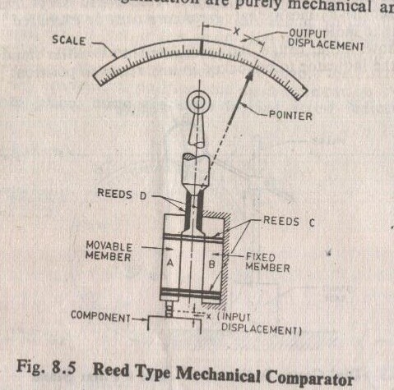
MECHANICAL COMPARATORS
3. Reed Type Mechanical Comparator:

Slide 8
MECHANICAL COMPARATORS
3. Reed Type Mechanical Comparator:
The scale is calibrated by means of block gauges & indicates the difference in displacement of the fixed & the moveable elements
There is no friction & the hysteresis effect is minimized by using suitable steel for the reeds
Comparators of this class have sensitivities of the order of 0.25 x10⁻³mm/scale division
Mechanical amplification is usually less than 100, but it is multiplied by optical lens system.
It is available in amplification ranges from x500 to x1000

Slide 9
MECHANICAL COMPARATORS
4. Passameter External Indicating Gauge:
This was made by Carl Zeiss
It is used for measuring external diameters as shown in figure
It has two anvils in its bow frame, the one on the right is fixed, but the other is moveable, & its position is reordered on scale by means of magnifying mechanism operating a pointer
The scale has 40 divisions ( each representing 0.0001 in) on either side of zero line

Slide 10
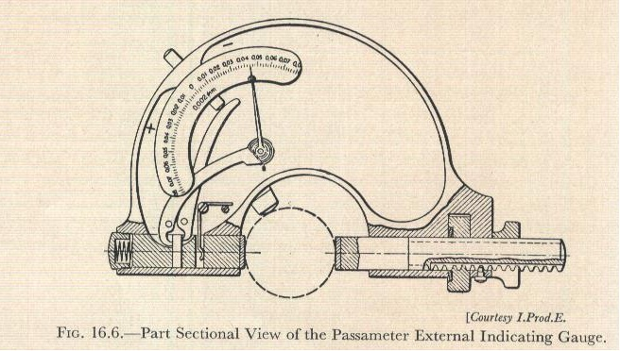
MECHANICAL COMPARATORS
4. Passameter External Indicating Gauge:

Slide 11
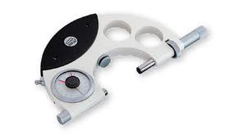
MECHANICAL COMPARATORS
4. Passameter External Indicating Gauge:

Slide 12
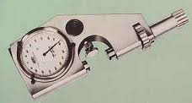
MECHANICAL COMPARATORS
4. Passameter External Indicating Gauge:

Slide 13
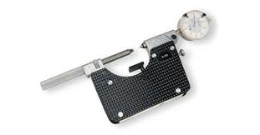
MECHANICAL COMPARATORS
4. Passameter External Indicating Gauge:

Slide 14
MECHANICAL COMPARATORS
4. Passameter External Indicating Gauge:
The working force b/w the anvils is about 12oz
Instruments vary in size, but are capable of accepting work b/w 0 & 6 inch diameter
The range of the pointer is ±0.003in.
The magnification is about 300
The permissible error in the gauge is ±0.00004in

Slide 15
MECHANICAL COMPARATORS
5. Sigma Comparator:
It is an excellent example of modern mechanical comparator
Magnification range of this instrument is form 300 to 5000.
Use of this instrument may be greatly extended by means of especially designed contacts & attachments to include internal diameter of screw thread
The details & magnifying system of the comparator are shown in figures on next slide

Slide 16
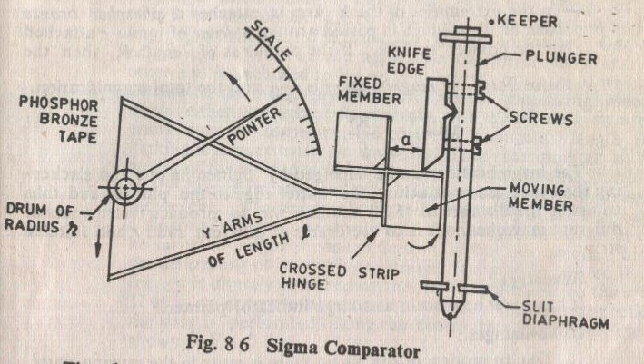
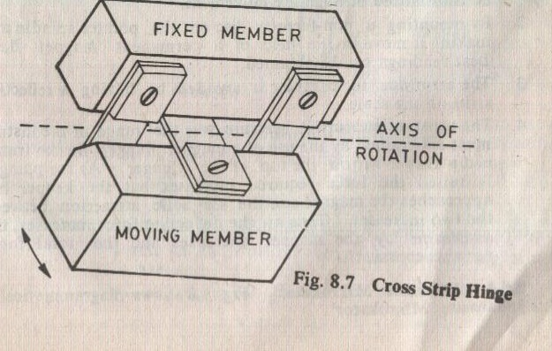

Slide 17
MECHANICAL COMPARATORS
5. Sigma Comparator:
The plunger is mounted on a pair of slit diagram to give a frictionless linear motion, has mounted upon the face of the moving member of a cross strip hinge
This hinge consists of a moving component & a fixed member connected by flexible strips alternatively at right angle
When external force is applied on moving member, it would pivot as would a hinge about the line of intersection of the strips

Slide 18
MECHANICAL COMPARATORS
5. Sigma Comparator:
An arm (which divides into Y form) is attached to the moving member. If the length of the arm is ‘l’ & the distance from the hinge pivot to the knife edge is ‘a’, then first stage of magnification is l/a
To the extremities to the Y , an arm is attached a phosphor bronze band or strip which is passed around a drum of radius r attached to a pointer spindle. If the pointer is of length R, then the 2nd stage of magnification is R/r
And the total magnification is : l/a x R/r

Slide 19
MECHANICAL COMPARATORS
5. Sigma Comparator:
The magnification can be changed by tightening one and slackening the other screw attaching the knife edge to the plunger & thus adjusting the distance a
An other way to produce instrument of different magnification is to use drums of different radii r & suitable strip

Slide 20
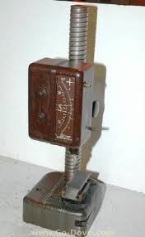
MECHANICAL COMPARATORS
5. Sigma Comparator:

Slide 21
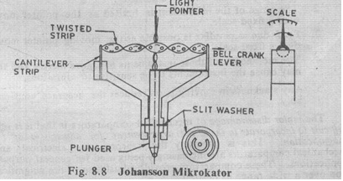
MECHANICAL COMPARATORS
5. Sigma Comparator:
Advantage/disadvantages of sigma comparator
DO YOUR SELF
6. Johnson Mikrokator:
DO YOUR SELF

